Slide 1
MUSIC STORE DATA ANALYSIS
VIJAY KUMAR

Slide 2
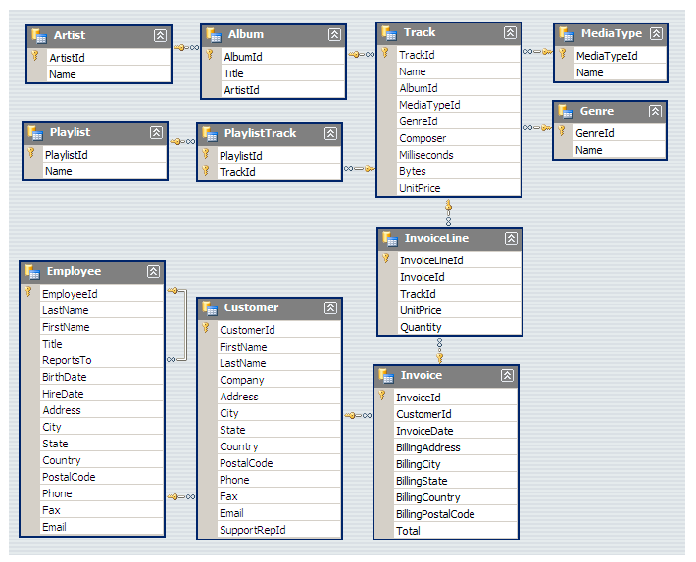
SCHEMA

Slide 3
Who is the senior most employee based on job title?
SELECT * FROM EMPLOYEE
ORDER BY LEVELS DESC
LIMIT 1;

Slide 4
Which countries have the most Invoices?
SELECT BILLING_COUNTRY, COUNT(*) AS NUMBER_OF_INVOICES FROM INVOICE
GROUP BY BILLING_COUNTRY
ORDER BY NUMBER_OF_INVOICES DESC
LIMIT 3;

Slide 5
What are top 3 values of total invoice?
SELECT TOTAL FROM INVOICE
ORDER BY 1 DESC
LIMIT 3;

Slide 6
Which city has the best customers? We would like to throw a promotional Music Festival in the city we made the most money. Write a query that returns one city that has the highest sum of invoice totals. Return both the city name & sum of all invoice totals.
SELECT BILLING_CITY,SUM(TOTAL) AS INVOICETOTAL
FROM INVOICE
GROUP BY BILLING_CITY
ORDER BY INVOICETOTAL DESC
LIMIT 1;

Slide 7
Who is the best customer? The customer who has spent the most money will be declared the best customer. Write a query that returns the person who has spent the most money
SELECT CONCAT(CUS.FIRST_NAME,' ',CUS.LAST_NAME) AS FULL_NAME, SUM(INVO.TOTAL) AS GROUP_TOTAL FROM CUSTOMER CUS
JOIN INVOICE INVO ON
INVO.CUSTOMER_ID = CUS.CUSTOMER_ID
GROUP BY FULL_NAME
ORDER BY GROUP_TOTAL DESC
LIMIT 1;

Slide 8
Write query to return the email, first name, last name, & Genre of all Rock Music listeners. Return your list ordered alphabetically by email starting with A
SELECT CUS.EMAIL, CUS.FIRST_NAME, CUS.LAST_NAME, GENRE.NAME
FROM CUSTOMER CUS JOIN INVOICE ON
INVOICE.CUSTOMER_ID = CUS.CUSTOMER_ID
JOIN INVOICE_LINE ON INVOICE.INVOICE_ID = INVOICE_LINE.INVOICE_ID
JOIN TRACK ON INVOICE_LINE.TRACK_ID = TRACK .TRACK_ID
JOIN GENRE ON TRACK.GENRE_ID =GENRE.GENRE_ID
WHERE GENRE.NAME LIKE 'ROCK'
ORDER BY 1;

Slide 9
Let's invite the artists who have written the most rock music in our dataset. Write a query that returns the Artist name and total track count of the top 10 rock bands
SELECT ARTIST.NAME, COUNT(ARTIST.NAME) AS NUMBER_OF_SONGS FROM ARTIST
JOIN ALBUM ON ARTIST.ARTIST_ID = ALBUM.ARTIST_ID
JOIN TRACK ON ALBUM.ALBUM_ID = TRACK.ALBUM_ID
JOIN GENRE ON GENRE.GENRE_ID = TRACK.GENRE_ID
WHERE GENRE.NAME LIKE 'ROCK'
GROUP BY ARTIST.NAME
ORDER BY NUMBER_OF_SONGS DESC
LIMIT 10;

Slide 10
Return all the track names that have a song length longer than the average song length. Return the Name and Milliseconds for each track. Order by the song length with the longest songs listed first.
SELECT NAME, MILLISECONDS FROM TRACK
WHERE MILLISECONDS > (SELECT AVG(MILLISECONDS) AS AVG_TRACK_LENGTH FROM TRACK )
ORDER BY MILLISECONDS DESC;

Slide 11
Find how much amount spent by each customer on artists? Write a query to return customer name, artist name and total spent
WITH BEST_SELLING_ARTIST AS (
SELECT ARTIST.ARTIST_ID AS ARTIST_ID, ARTIST.NAME AS ARTIST_NAME,
SUM(INVOICE_LINE.UNIT_PRICE*INVOICE_LINE.QUANTITY) AS TOTAL_SALES
FROM INVOICE_LINE
JOIN TRACK ON TRACK.TRACK_ID = INVOICE_LINE.TRACK_ID
JOIN ALBUM ON ALBUM.ALBUM_ID = TRACK.ALBUM_ID
JOIN ARTIST ON ARTIST.ARTIST_ID = ALBUM.ARTIST_ID
GROUP BY 1
ORDER BY 3 DESC
LIMIT 1)

Slide 12
SELECT C.CUSTOMER_ID, C.FIRST_NAME, C.LAST_NAME, BSA.ARTIST_NAME, SUM(IL.UNIT_PRICE*IL.QUANTITY) AS
AMOUNT_SPENT
FROM INVOICE I
JOIN CUSTOMER C ON C.CUSTOMER_ID = I.CUSTOMER_ID
JOIN INVOICE_LINE IL ON IL.INVOICE_ID = I.INVOICE_ID
JOIN TRACK T ON T.TRACK_ID = IL.TRACK_ID
JOIN ALBUM ALB ON ALB.ALBUM_ID = T.ALBUM_ID
JOIN BEST_SELLING_ARTIST BSA ON BSA.ARTIST_ID = ALB.ARTIST_ID
GROUP BY 1,2,3,4
ORDER BY 5 DESC;

Slide 13
We want to find out the most popular music Genre for each country. We determine the most popular genre as the genre with the highest amount of purchases. Write a query that returns each country along with the top Genre. For countries where the maximum number of purchases is shared return all Genres.

Slide 14
WITH CTE AS (
SELECT GENRE.NAME, CUSTOMER.COUNTRY,COUNT(INVOICE_LINE.QUANTITY) AS MOST_POPULAR_GENRE,
ROW_NUMBER() OVER(PARTITION BY CUSTOMER.COUNTRY ORDER BY
COUNT(INVOICE_LINE.QUANTITY) DESC) AS ROWNO
FROM CUSTOMER
JOIN INVOICE ON INVOICE.CUSTOMER_ID =CUSTOMER.CUSTOMER_ID
JOIN INVOICE_LINE ON INVOICE_LINE.INVOICE_ID = INVOICE.INVOICE_ID
JOIN TRACK ON TRACK.TRACK_ID = INVOICE_LINE.TRACK_ID
JOIN GENRE ON GENRE.GENRE_ID = TRACK.GENRE_ID
GROUP BY 1,2
ORDER BY 2 ASC ,3 DESC)
SELECT COUNTRY, NAME, MOST_POPULAR_GENRE FROM CTE
WHERE ROWNO <= 1

Slide 15
Write a query that determines the customer that has spent the most on music for each country. Write a query that returns the country along with the top customer and how much they spent. For countries where the top amount spent is shared, provide all customers who spent this amount.

Slide 16
WITH CTE AS (
SELECT CUSTOMER.FIRST_NAME,CUSTOMER.LAST_NAME ,CUSTOMER.COUNTRY, SUM(INVOICE.TOTAL) AS TOTAL_SPEND,
ROW_NUMBER()OVER(PARTITION BY CUSTOMER.COUNTRY ORDER BY SUM(INVOICE.TOTAL) DESC ) AS ROWNO
FROM CUSTOMER
JOIN INVOICE ON CUSTOMER.CUSTOMER_ID = INVOICE.CUSTOMER_ID
GROUP BY 1 ,2,3
ORDER BY 3 ASC, 4 DESC )
SELECT FIRST_NAME, COUNTRY, TOTAL_SPEND FROM CTE
WHERE ROWNO <= 1

